Slide 1
Discovery Potion
Practical Bioinformatics

Slide 2
AIM:
We have designed a web application that will allow users the ability to predict whether a compound has an inhibitory effect against a chosen target protein or not.
We will use acetylcholinesterase as our target protein for computational drug prediction.

Slide 3
Why choose acetylcholinesterase
Acetylcholinesterase (AChE) is an enzyme that catalyzes the breakdown of the neurotransmitter acetylcholine that is essential for cognition and memory.This can lead to Alzheimer’s. Therefore, the inhibition of AChE is a therapeutic strategy for the treatment of Alzheimer’s.
Alzheimer's Disease is a neurodegenerative disease that progressively worsens with time. The symptoms of Alzheimer’s disease involves detrimental changes in thinking, remembering, reasoning, and behavior.

Slide 4
Hypothesis
We will test the bioactivity of a compound on acetylcholinesterase enzyme by using the datasets from chEMBL database. We will take into consideration the IC50 values for each of the compounds( IC50 is the drug potency values at 50% of maximal effect).
We further analyse the drug data(using Lipinski’s rule of 5, pIC50 values etc.) and use the data values to build a Machine Learning dataset. Using this we can predict the drug efficacy of a compound towards inhibiting AChE

Slide 5
Literature Backing
Learnings:
Analysed acetylcholinesterase and its bioactivity through chEMBL database.
Significance of IC50 values for bioactivity and the need to normalise the data by evaluation pIC50 for further drug efficacy.
Use QSAR(Quantitative Structure-Activity relationship) model to predict biological activities through functions of biological descriptors
Probing the origins of human acetylcholinesterase inhibition via QSAR modeling and molecular docking [PeerJ]: https://peerj.com/articles/2322/

Slide 6
Property analysis for drug design: https://pubmed.ncbi.nlm.nih.gov/10756480/
Learnings
We analysed the research paper to understand the Lipinski Descriptors in detail.
We investigated how Lipinski's rule of five can be implemented on our dataset.
It helped us in understanding various factors which contribute to the drug likeness of a compound.

Slide 7
Learnings
Generation of PubChem fingerprints by PaDEL software
Significance of PaDEL descriptors for ML modelling
Use of Random Forest Regression model for drug prediction
Detailed analysis of PubChem descriptors generated by PaDEL software:
https://www.researchgate.net/publication/333036509_Toxicity_prediction_of_small_drug_molecules_of_aryl_hydrocarbon_receptor_using_proposed_ensemble_model/download

Slide 8
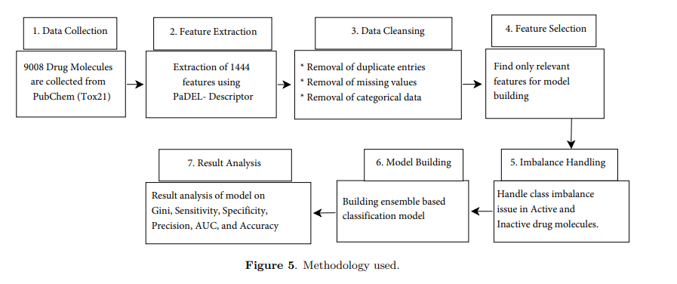

Slide 9
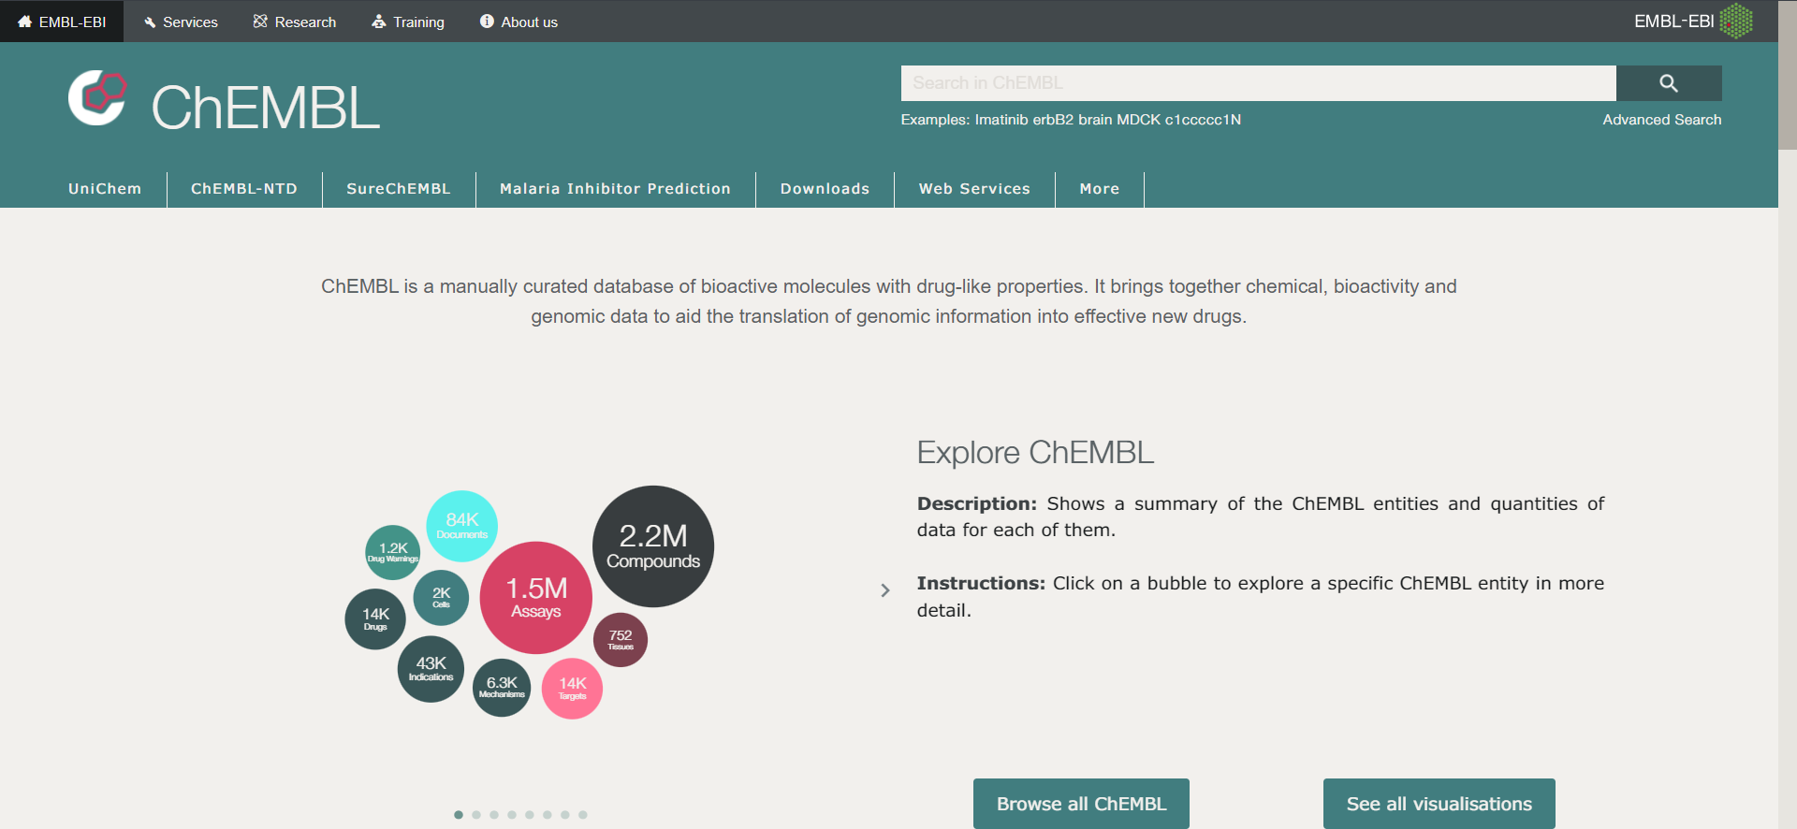

Slide 10
Implementation Plan
Data Extraction and analysis from ChEMBL database for acetylcholinesterase.
05
Implementation of prediction model as a web application
01
04
Use of Random Forest Regression model to predict pIC50 values
Lipinski Descriptor calculation, Normalisation and statistical analysis
02
03
Use of PaDEL software to generate biological footprints for input to ML model

Slide 11
Current Progress

Slide 12
Step 1: Data Extraction and Analysis
We downloaded bioactivity data for acetylcholinesterase from the ChEMBL database.
We analyse this data based on the standard value(IC50) and divide the dataset into 3 categories namely,
Active(IC50<=1000 nM)
Inactive(IC50>=10000 nM)
Intermediate(1000 nM <IC50<10000 nM)
Drug with lower IC50 value is a better inhibitor

Slide 13
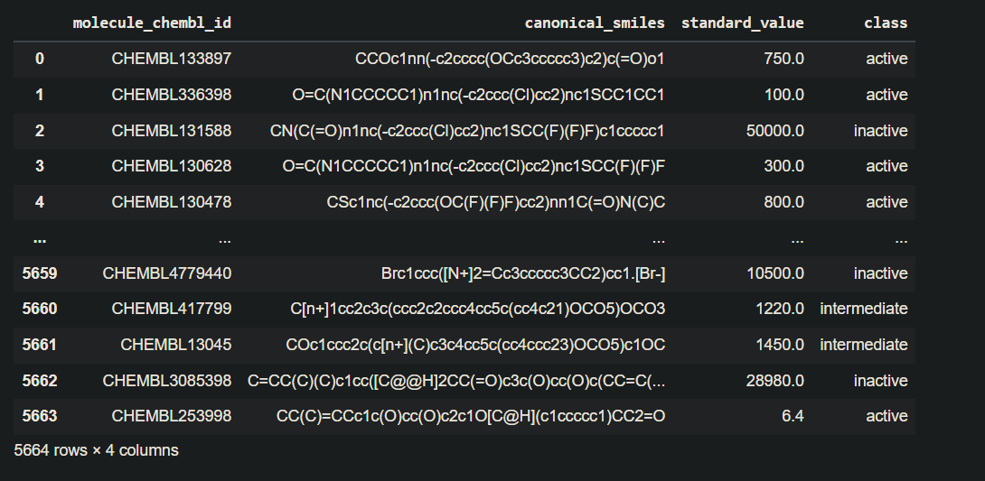

Slide 14
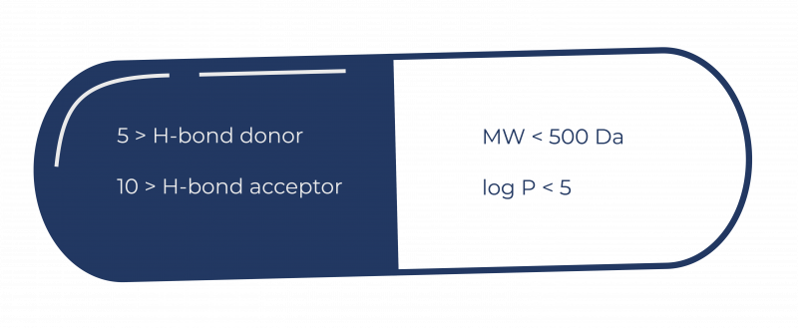
Step 2: Lipinski Descriptors analysis and Normalisation
We removed the datasets with multiple discrete molecules, in the chemical structure and selected the largest molecule amongst them.
We further filtered the data using Lipinski rule of five on the bioactivity data:
logP :octanol water partition coefficient, MW: molecular weight

Slide 15
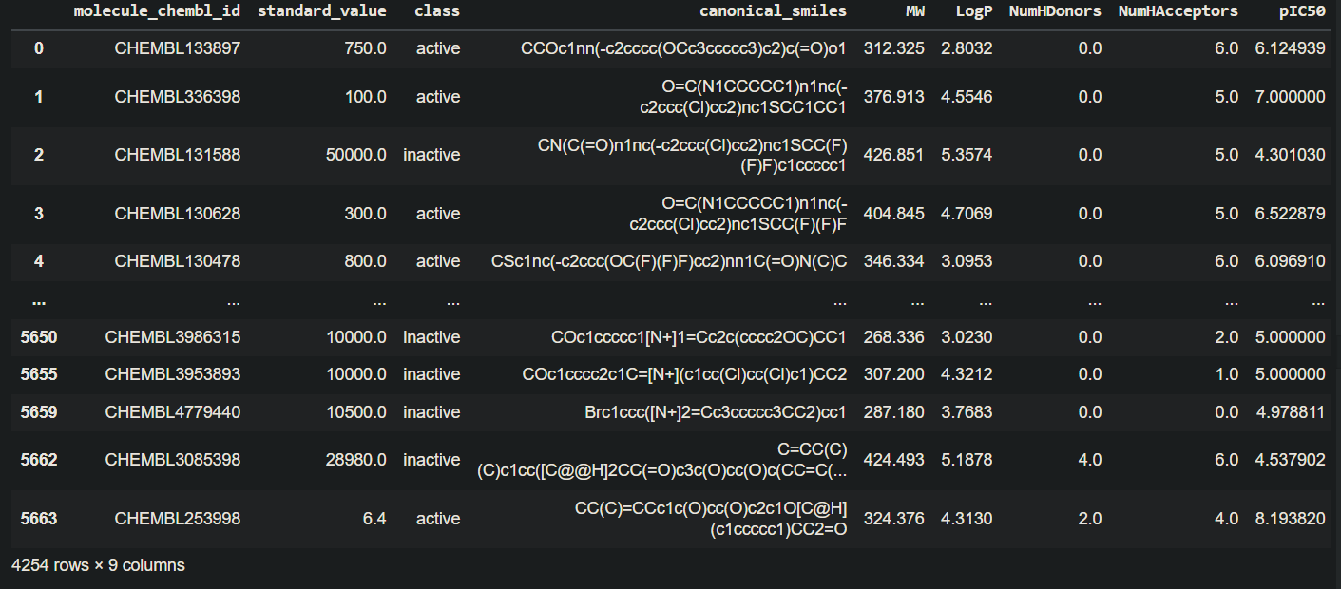
pIC50(-log(IC50)) values were calculated to normalise the data for standard value and analyse data on a symmetric scale. This gives us information about drug potency.
We combine all the data and use it for statistical analysis to observe differences in active and non-active compounds.

Slide 16
Step 3: PaDEL software for fingerprint generation
From the bioactivity data obtained in earlier steps, we work with the columns of ‘canonical smiles’, and ‘molecule_chembl_id’
Using PaDEL-Descriptor software we calculate the molecular descriptors of the canonical smiles of each compound(like bond length, hybridization etc).
We convert the obtained data into separate X and Y matrices.
Create X as a subset data containing the PubChem descriptors values for each compound.
Set Y as the pIC50 (converted from IC50) values for these compounds.

Slide 17
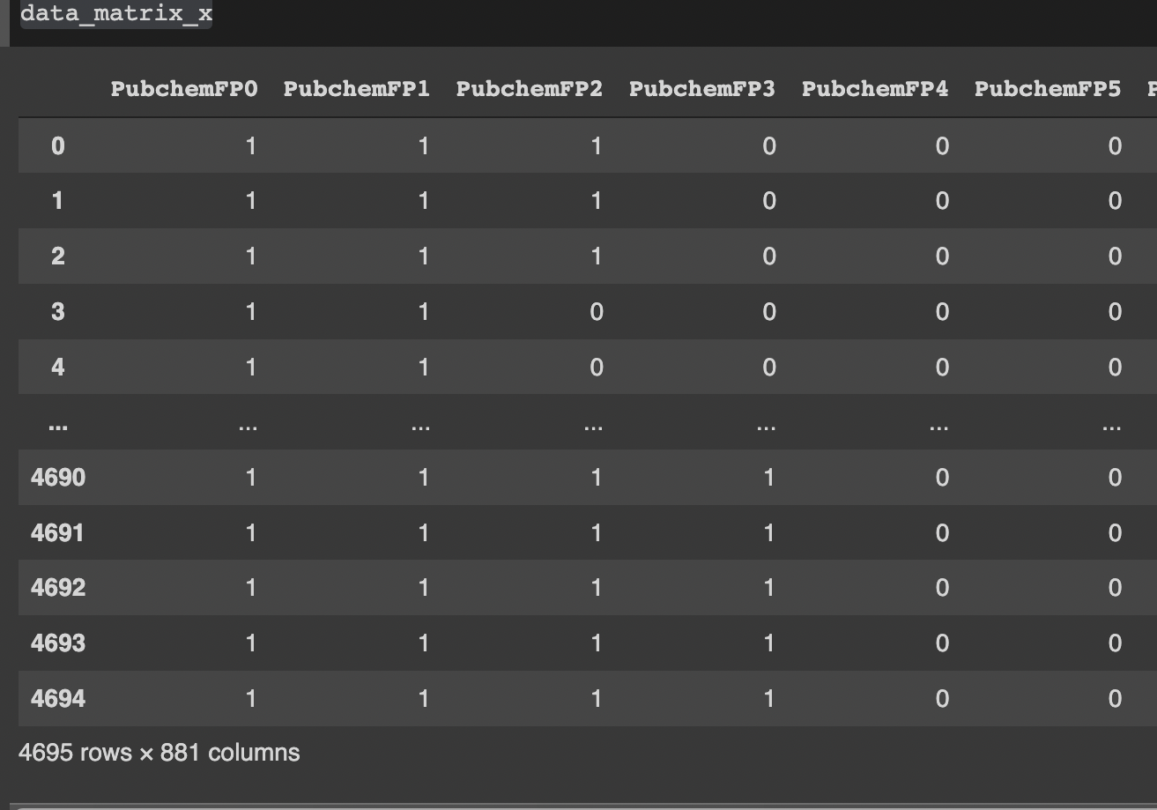
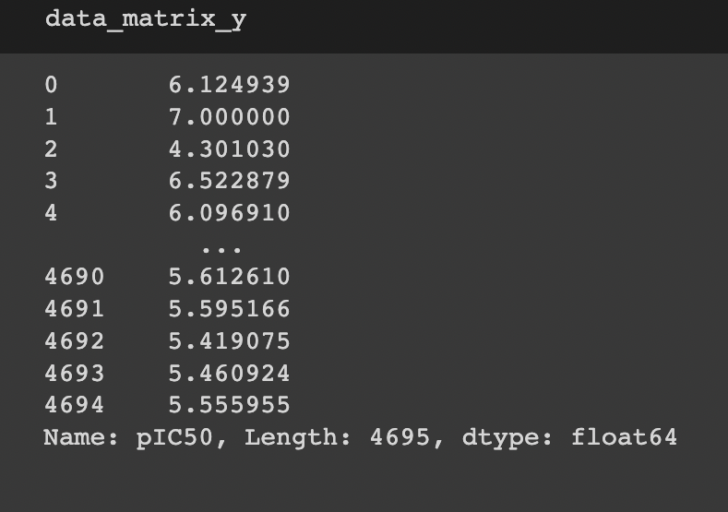
X→ Y→

Slide 18
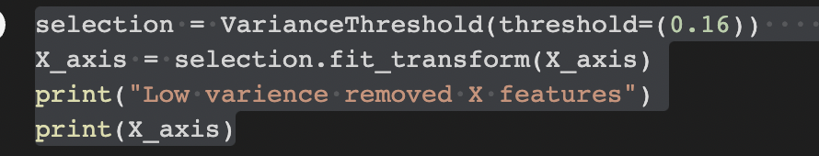
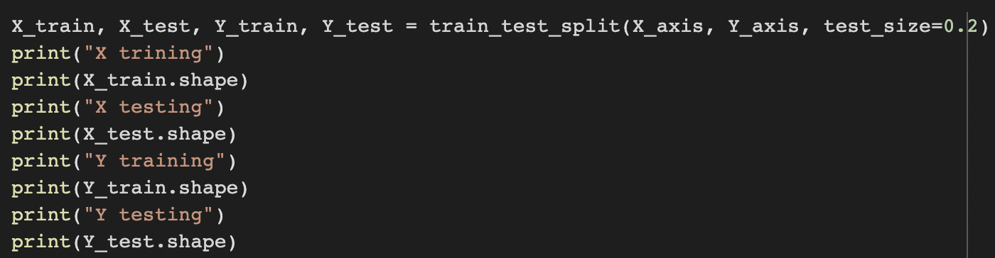
Step 4: Training Machine Learning Model
Set a threshold variance for the X matrix obtained in the previous step.
Reference for threshold variance calculation: https://analyticsindiamag.com/hands-on-guide-to-padelpy-for-ml-model-building/
Partitioning the X and Y data in 80:20 ratio so as to perform training on the 80% set and testing on the 20% set.

Slide 19
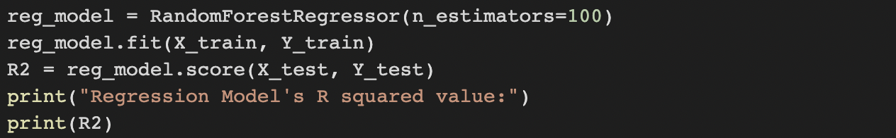

Input the training X matrix and training Y vector as Inputs to Random Forest Regression modelling for pIC50 predictions.
Obtain the R squared value for the fit of testing X and Y data in the regression model obtained in previous point.
Predict the Y value using the testing X data.

Slide 20
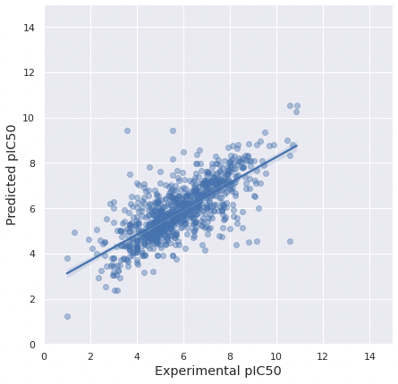
Plot the predicted Y vs experimental Y data to visualize the fit.
Predicted pIC50 vs Experimental pIC50

Slide 21


Slide 22
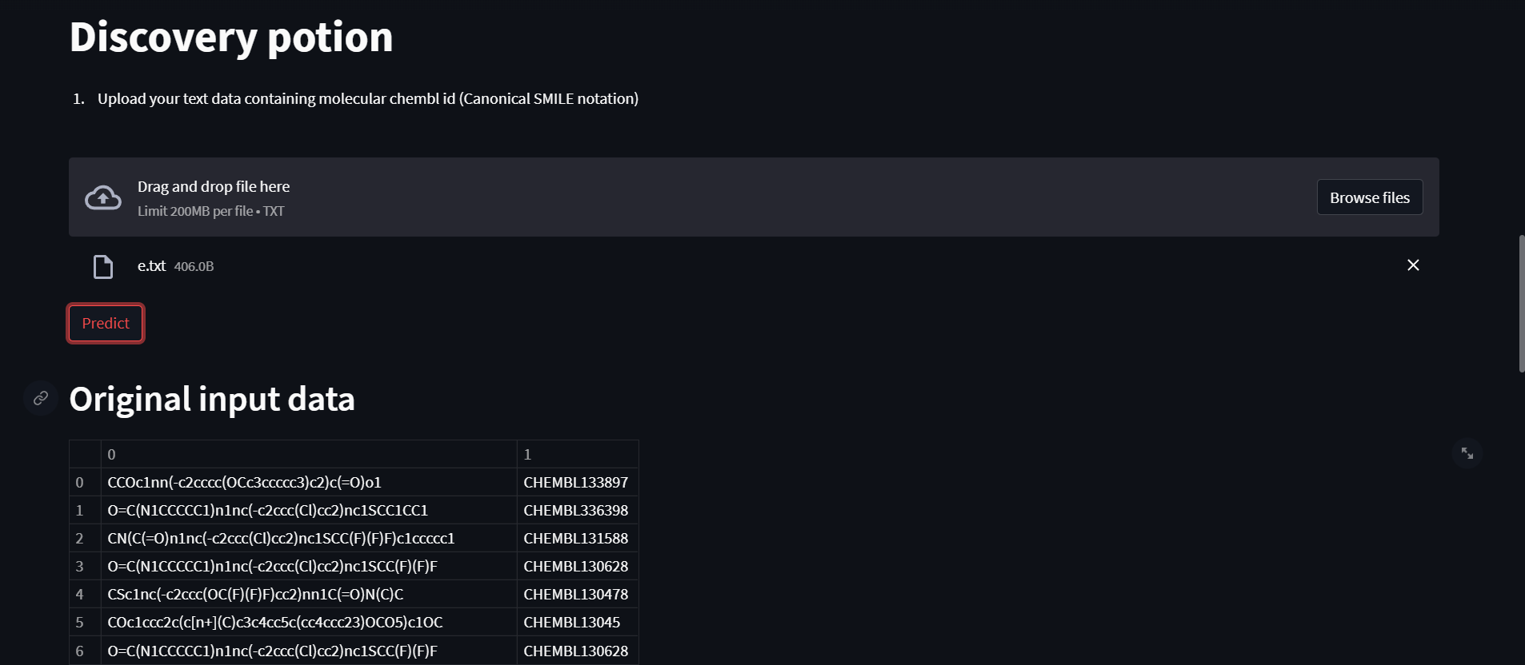
https://github.com/Abdul-Aziz-Mustafa/Discovery-Potion

Slide 23
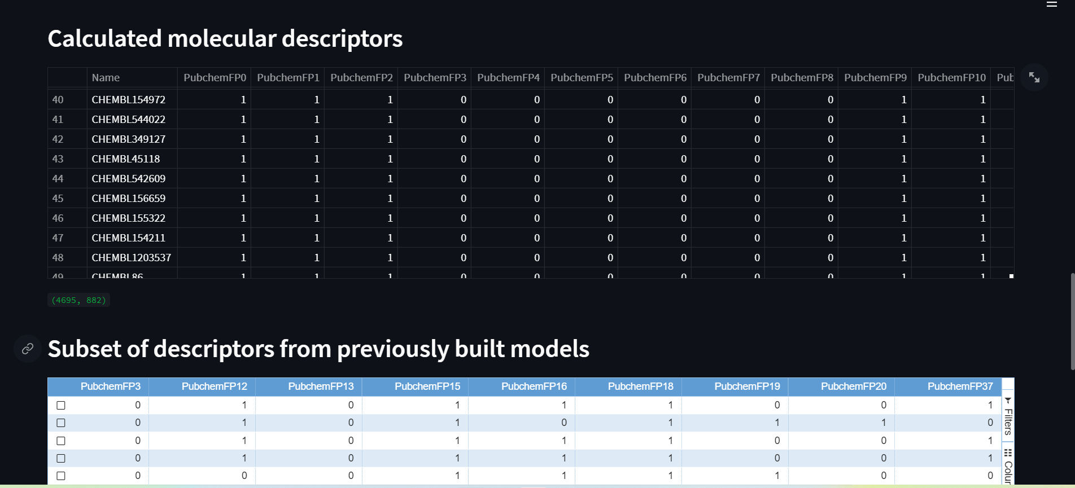
https://github.com/Abdul-Aziz-Mustafa/Discovery-Potion

Slide 24
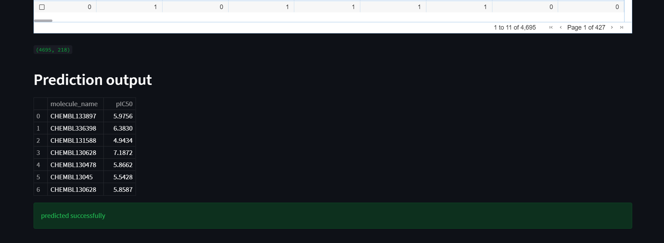
https://github.com/Abdul-Aziz-Mustafa/Discovery-Potion

Slide 25
THANKS!
https://github.com/Abdul-Aziz-Mustafa/Discovery-Potion
Group Number 6:
Abdul Aziz (2020485)
Arjun Temura (2020497)
Aman Kumar (2020492)
Ayush Raje Chak (2020502)
Mohd Zaid (2020525)
Shreya Bhatia (2020542)

